Slide 1
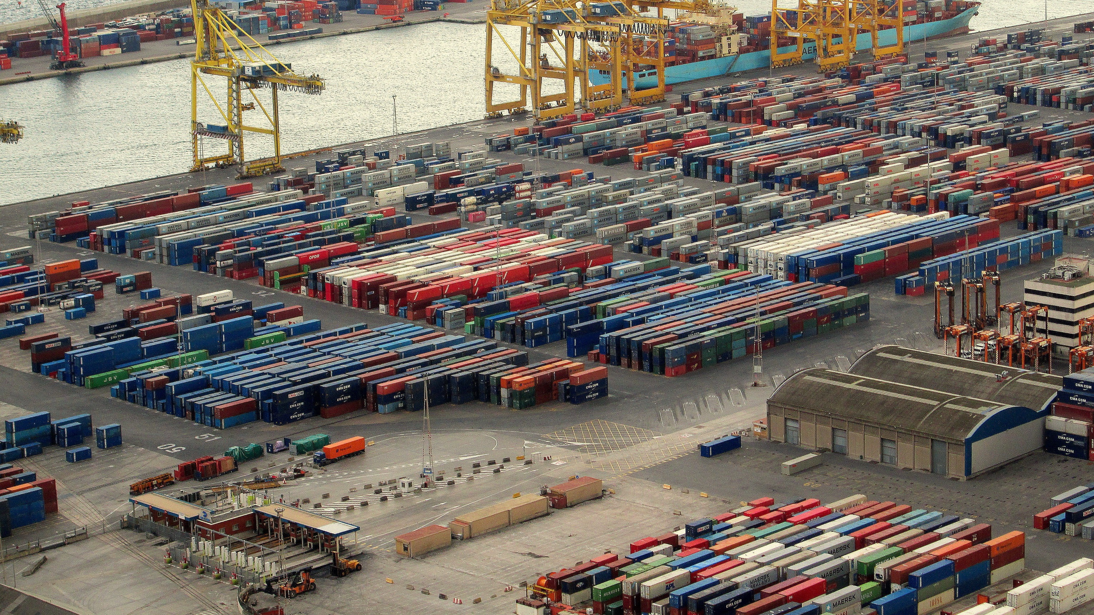


trading Volume of Saudi Arabia
Ahmad Abusabaeen
9/3/2022

Slide 2


How much has the Saudi economy been affected by covid-19?
Lockdown
Shifting to online = Less oil consumption
Thus, lower tendency towards oil imports

Slide 3


Outline
Introduction
Historical overview on exports
Top exports
Effect of COVID-19 on exports
Overview on imports
Top imports
Effect of COVID-19 on imports
Conclusion
This Photo by Unknown Author is licensed under CC BY-NC-ND

Slide 4
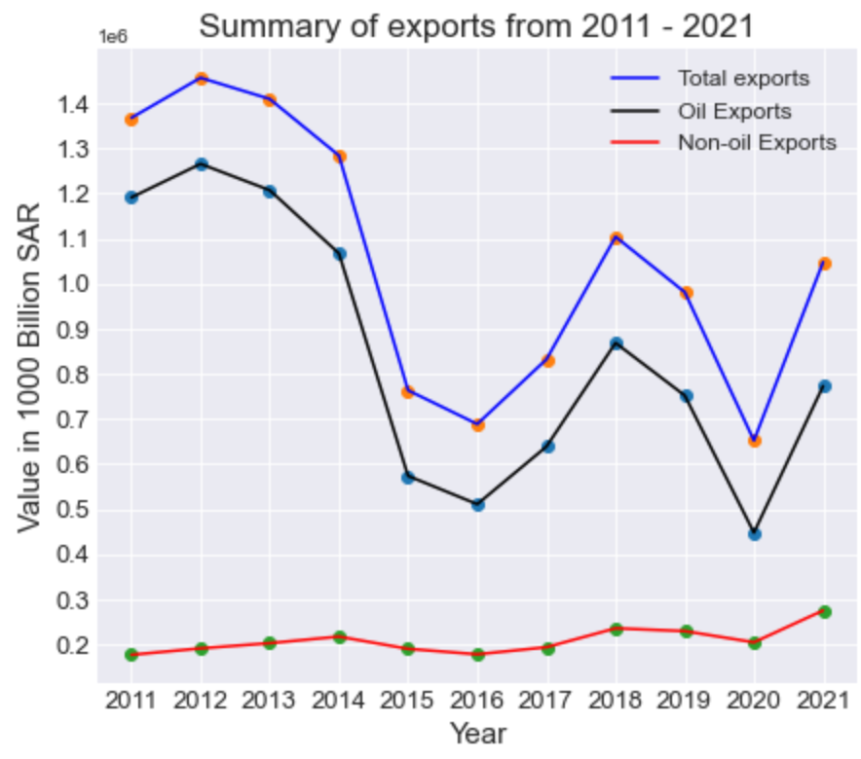
Overview on exports
% 80 of Saudi’s economy relies on oil-exports
Total exports from 2011- 2021: (SAR 11,586 B)
Oil exports %80: (SAR 9,294 B)
Non-Oil exports %20: (SAR 2,292 B)

Slide 5
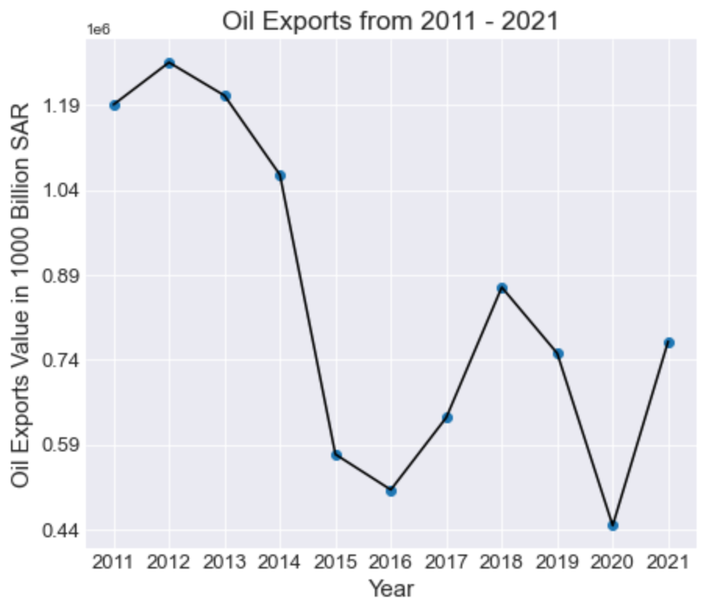
Oil Exports
Highest: 2012
SAR 1265.6 B
Average Price = $ 94
Mean = SAR 1054 B
Lowest: 2020
SAR 447.6 B
2020 Average Price = $ 40

Slide 6
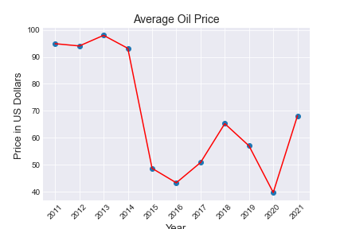
Oil Price
Highest Average Price = $98 (2013)
Mean Average Price = $68
Lowest Average price = $40 (2020)
And Weight, but unavailable

Slide 7
How much has the Saudi economy been affected by covid-19?
State the main take-home message at the beginning of your talk.
% 80 of Saudi’s economy relies on oil-exports
-%40 drop in 2020 compared to 2019 (oil)
Lowest oil exports since 2011
Imports:(% 10 drop 2019 to 2020)
Mainly:
Mechanical, & electrical appliances
Vehicles, aircraft, & vessels
The market became less busy?
Notes:
%30 of drop in economy

Slide 8
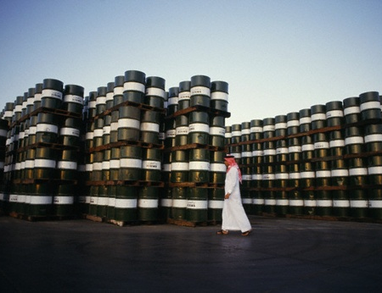
Introduction
What does Saudi Arabia export the most?
What is the ratio of oil exports to non-oil exports?
This Photo by Unknown Author is licensed under CC BY
Notes:
What factors covid-19 effected?

Slide 9
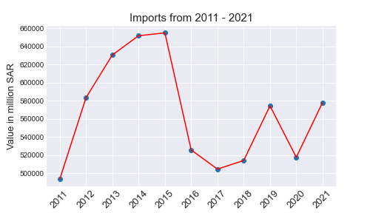
Volume of Saudi imports
Total Imports: SAR 6,228 B
Highest: 2015 = SAR 655 B
Lowest: 2011 = SAR 493 B
2019 = SAR 574 B
2020= SAR 517 B
2021 = SAR 578 B

Slide 10
Why Saudi Arabia?
Member of G20 (Group of twenty world’s leading economies)
Member of OPEC (Organization of the Petroleum Exporting Countries)
World’s second largest reserves of oil.
Strategic location (Asia, Africa, and Europe)

Slide 11
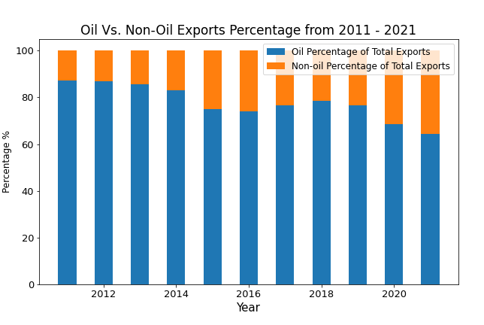
Top Saudi exports
Oil
Oil exports %80
Big drop of oil exports VALUE after 2014
Notes:
Starting to recover in 2018

Slide 12
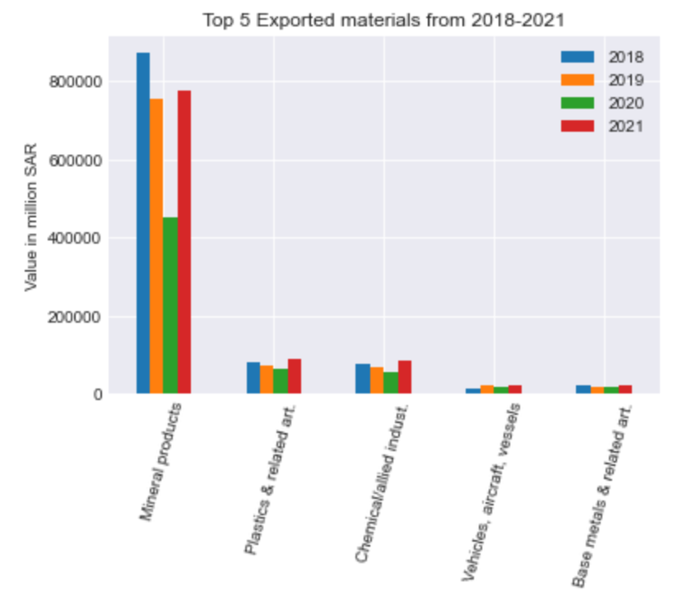
Non-Oil exports
Are the non-oil exports increasing?
Includes oil products
Since 2018:
1st: Mineral Products
2nd: Plastics
3rd: Chemicals

Slide 13
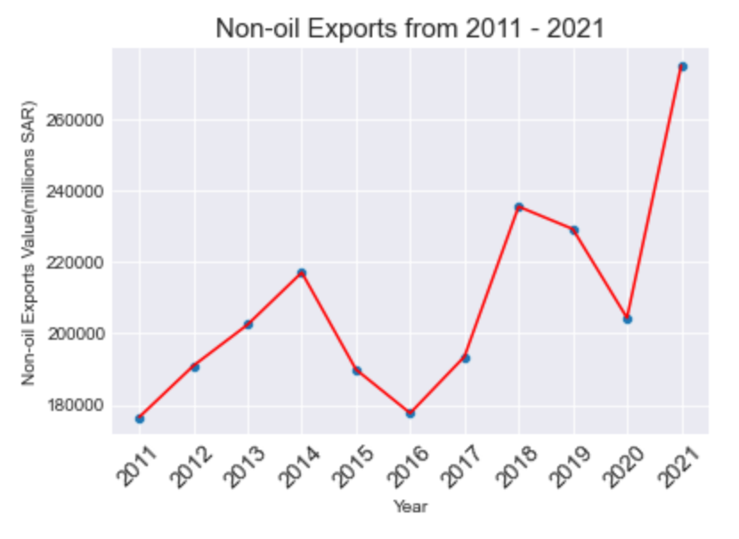
Non-Oil exports
Oil not involved at all
2011 – 2021 Total = SAR 2292 B
2016 = SAR 178 B (Lowest)
2019 = SAR 229 B
2020 = SAR 204 B
2021 = SAR 275 B (Highest)
%36 of total exports in 2021

Slide 14
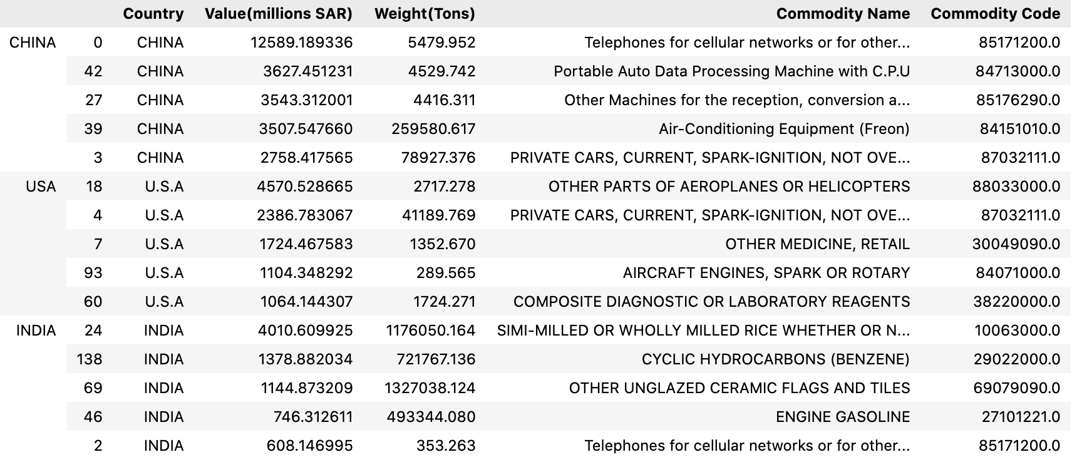
Top Saudi imports in 2020
By Tons:
China, United States, and India

Slide 15
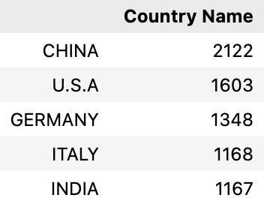
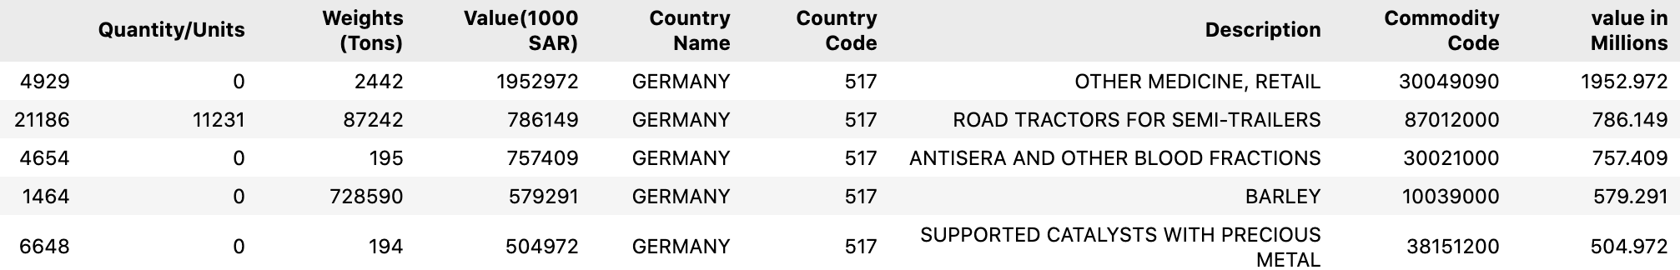
Top Saudi imports in 2020
By number of Commodities:
China, United States, and Germany

Slide 16
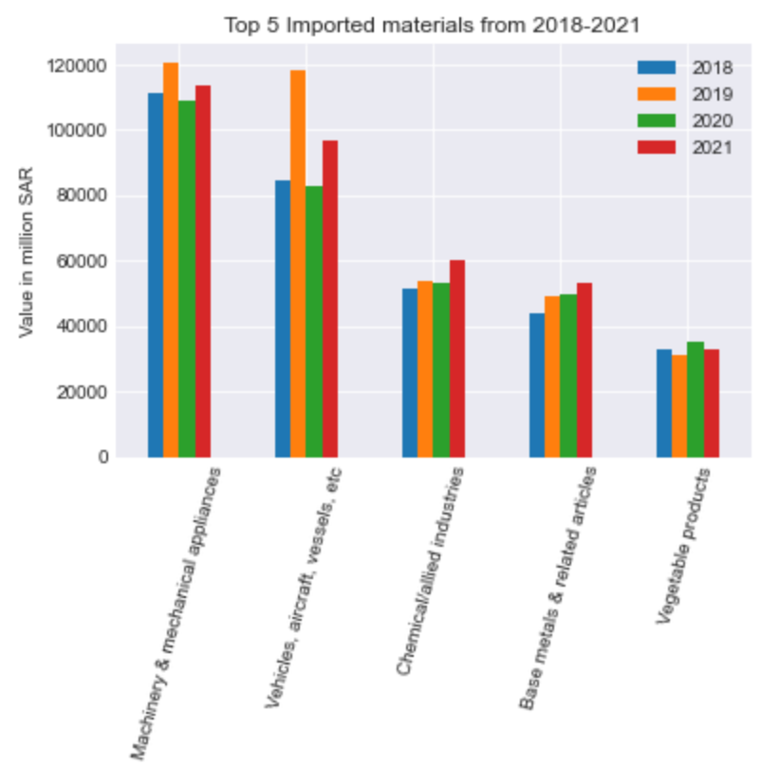
Top Saudi imports 2018-2021
Machinery, mechanical, & electrical appliances
Vehicles, aircraft, & vessels
-%30 2020- 2019
-%18 2021 - 2019
Chemicals
Base metals
Vegetables products

Slide 17
Statistical Trends
Non-oil exports in 2021 highest since 2011!
SAR 274.9 B

Slide 18
Covid-19 Effect on exports & imports
Exports:
-% 33, 329 Billion drop in exports in 2020 compared to 2019
+% 6, 66.6 Billion increase in exports in 2021 compared to 2019
VAT added 163 Billion in 2020
VAT added 232 Billion in 2021
Imports:
-%10 drop 2020 compared to 2019
+1% increase in 2021 compared to 2019

Slide 19
Problems encountered
Not uniformed data, such as sheets, values, and language

Slide 20
References
https://www.datacamp.com/community/tutorials/joining-dataframes-pandas?utm_source=adwords_ppc&utm_medium=cpc&utm_campaignid=1455363063&utm_adgroupid=65083631748&utm_device=c&utm_keyword=&utm_matchtype=&utm_network=g&utm_adpostion=&utm_creative=332602034358&utm_targetid=aud-299261629574:dsa-429603003980&utm_loc_interest_ms=&utm_loc_physical_ms=9076782&gclid=Cj0KCQiA64GRBhCZARIsAHOLriJSD4EDpEONsNz2t5vVxJNO_KPls4ktLMUG84pZq5K2n9SgY_AgZ1gaAphnEALw_wcB
https://www.opec.org/opec_web/en/about_us/169.htm
https://www.state.gov/u-s-relations-with-saudi-arabia/
https://www.macrotrends.net/2516/wti-crude-oil-prices-10-year-daily-chart
https://www.statista.com/statistics/1026237/saudi-arabia-vat-revenue/

Slide 21
Conclusion
Thank you!

